Slide 1
Beseye Cloud Security Co., Ltd.
h3 vlisualization in Taiwan
Iris @ Beseye
2024 / 01 / 26

Slide 2
Dataset
1. Population
2. Income
3. Charging station

Slide 3
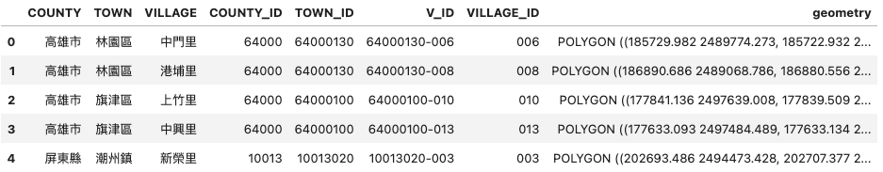
steps for preprocessing population data
Preprocess the data (referred to on the previous page) to transform it into a count format.
Merge the preprocessed data with a map that includes geometry, ensuring to match the granularity, so that the data contains a geometry column.
Create hexagons that cover Taiwan, which should include a geometry column.
Standardize the coordinates to EPSG:4326.
Run the algorithm on the data containing geometry fields (both hexagons and data).
Calculate the amount of data within each hexagon and upload the completed map to Ellipse.

Slide 4
steps for preprocessing population data
Preprocess the data (referred to on the previous page) to transform it into a count format.
Merge the preprocessed data with a map that includes geometry, ensuring to match the granularity, so that the data contains a geometry column.
Create hexagons that cover Taiwan, which should include a geometry column.
Standardize the coordinates to EPSG:4326.
Run the algorithm on the data containing geometry fields (both hexagons and data).
Calculate the amount of data within each hexagon and upload the completed map to Ellipse.

Slide 5
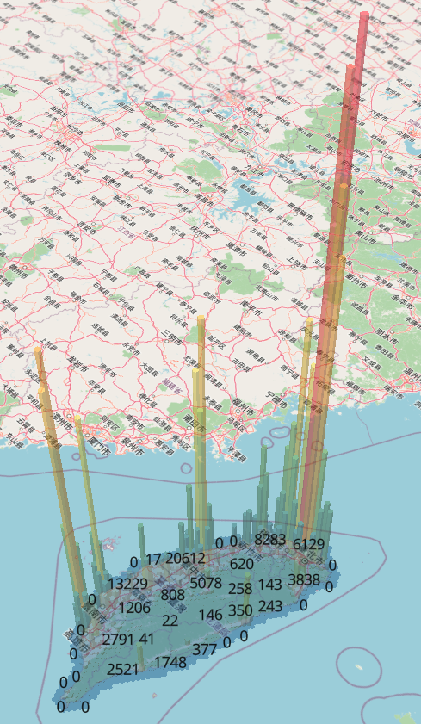
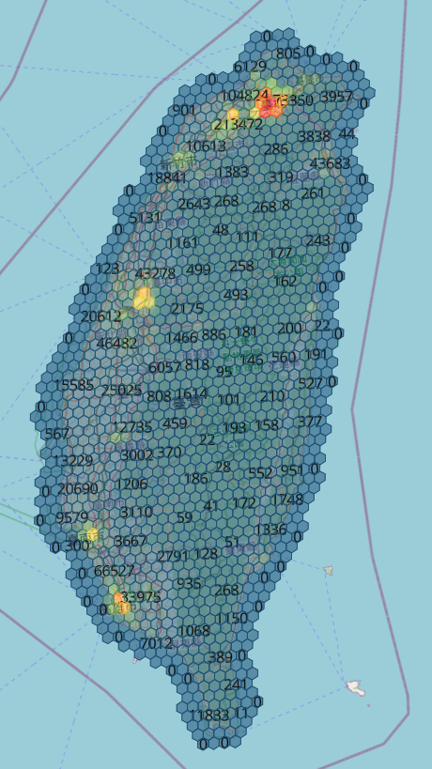
Visualization - population
Altitude weight = 1
https://app.ellipsis-drive.com/view?pathId=94a96cbb-fa8f-4
f2a-85d3-00079affb103&state=2481f362-770b-4801-ac5c-7c
8006673a34
Package name : Ellipsis
Document :
https://docs.ellipsis-drive.com/integrate-with-ed/use-viewer-as-embedded-window

Slide 6
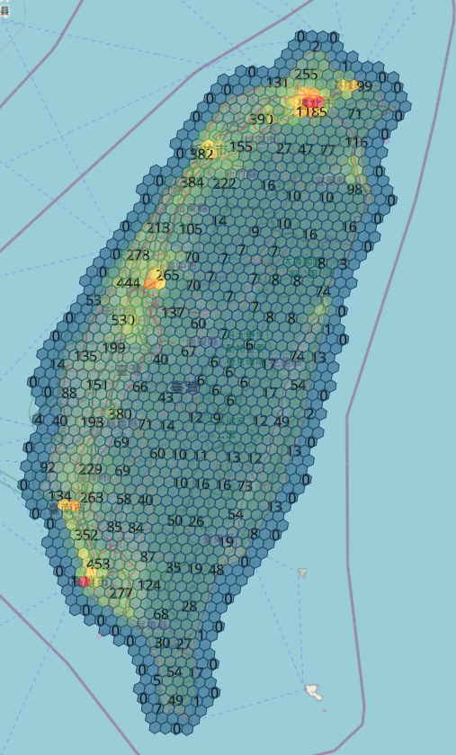
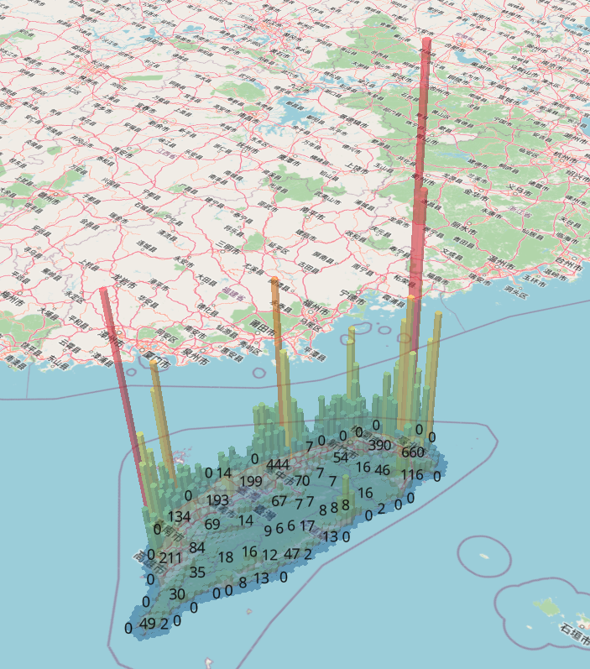
Visualization - income
Altitude weight = 200
https://app.ellipsis-drive.com/view?pathId=790af342-2513-41d7-8f60-43ece3e2825f&state=6648aa6c-b8e8-4809-8806-40c0105ef44d
Package name : Ellipsis
Document :
https://docs.ellipsis-drive.com/integrate-with-ed/use-viewer-as-embedded-window

Slide 7
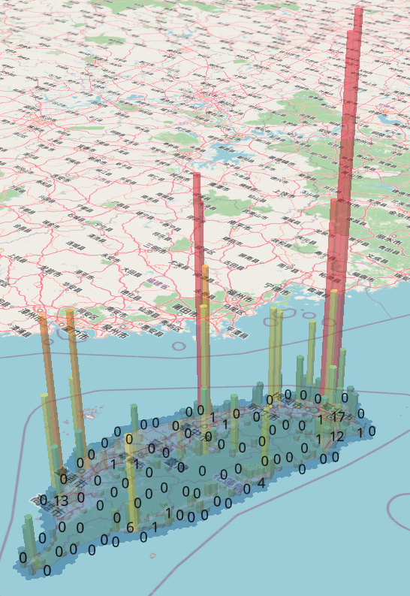
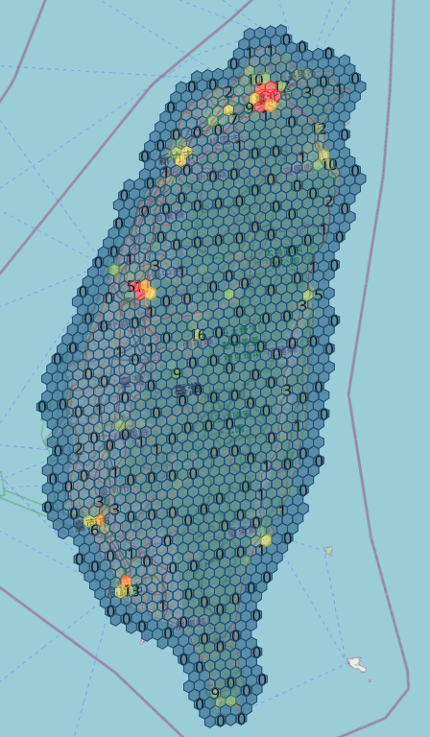
Visualization – charging station
Altitude weight = 5000
https://app.ellipsis-drive.com/
view?pathId=2707b5ce-e8f5-4d
28-9eef-748c9862041c&state=a
b443b6a-7a7b-4e88-9c99-9bef76af5836
Package name : Ellipsis
Document :
https://docs.ellipsis-drive.com/integrate-with-ed/use-viewer-as-embedded-window

Slide 8
steps for preprocessing population data
Preprocess the data (referred to on the previous page) to transform it into a count format.
Merge the preprocessed data with a map that includes geometry, ensuring to match the granularity, so that the data contains a geometry column.
Create hexagons that cover Taiwan, which should include a geometry column.
Standardize the coordinates to EPSG:4326.
Run the algorithm on the data containing geometry fields (both hexagons and data).
Calculate the amount of data within each hexagon and upload the completed map to Ellipse.

Slide 9


Algorithm
Step1: Calculate the intersection area between hexagons and population regions to obtain the area ratio.
Step2: Multiply the area ratio by the population count of the population regions to estimate the population for each area.
Assume the population is evenly distributed.
.
.
.
40/120 = 1/3
1000 * 1/3 = 333 people
area
40cm^2
383 people(This hexagon's population count)
10/200 = 1/20
30 * 1/20 = 1.5 people
=
area
10cm^2
Total population count
50/200 = ¼
30 * ¼ = 7.5 people
7.5 people(This hexagon's population count)
(for Validate)
600 people
50cm^2
30 people
200cm^2
Area
50cm^2
1000 people
120cm^2

Slide 10
steps for preprocessing population data
Preprocess the data (referred to on the previous page) to transform it into a count format.
Merge the preprocessed data with a map that includes geometry, ensuring to match the granularity, so that the data contains a geometry column.
Create hexagons that cover Taiwan, which should include a geometry column.
Standardize the coordinates to EPSG:4326.
Run the algorithm on the data containing geometry fields (both hexagons and data).
Calculate the amount of data within each hexagon and upload the completed map to Ellipse.

Slide 11
Determine hexagon parameters (based on population data)
Resolution
Distance
Should the map include offshore island areas?

Slide 12
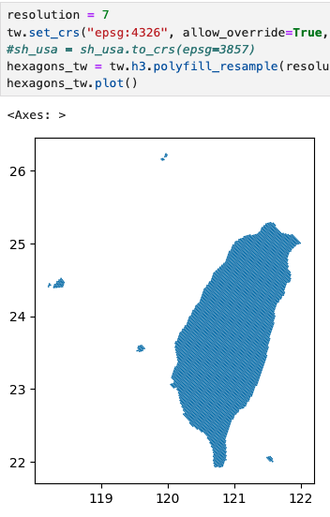
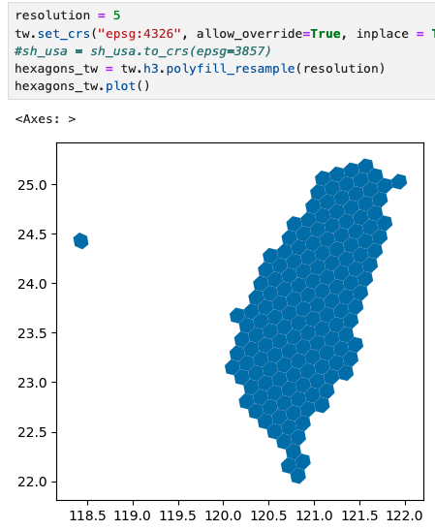
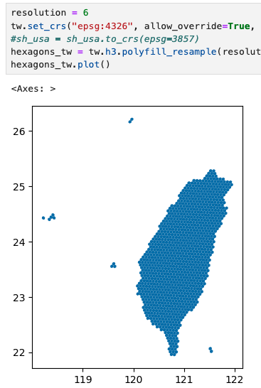
Resolution - definition
Actual total population: 23,375,314
(This page calculates including offshore islands.)
8448 hexagons
Total population in hexagons: 23,290,426.47
Error: 0.36%
1329 hexagons
Total population in hexagons: 23,323,999.50
Error: 0.22%
225 hexagons
Total population in hexagons: 23,181,911.90
Error: 0.82%
Notes:
取到小數點後第二位 x y fix

Slide 13
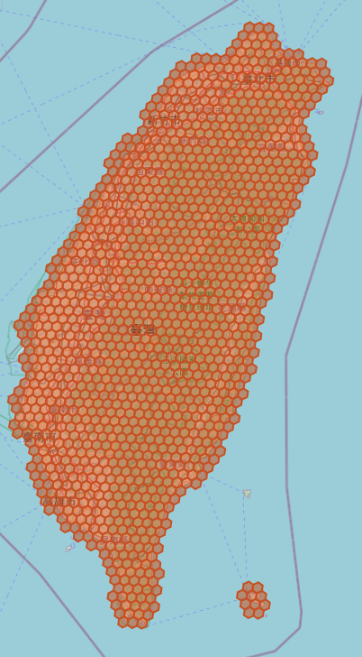
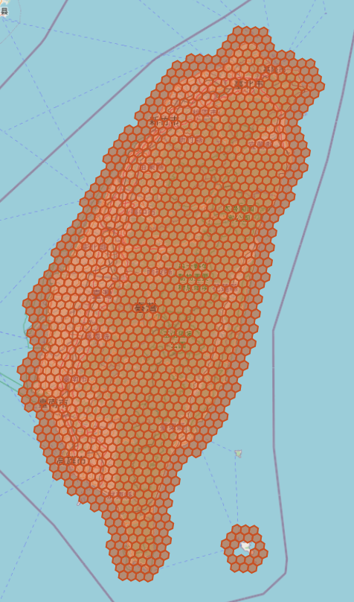


Distance - definition
Distance = 1
Distance = 2
Notes:
取到小數點後第二位 圖文要能看懂（畢竟不是口頭報告）

Slide 14
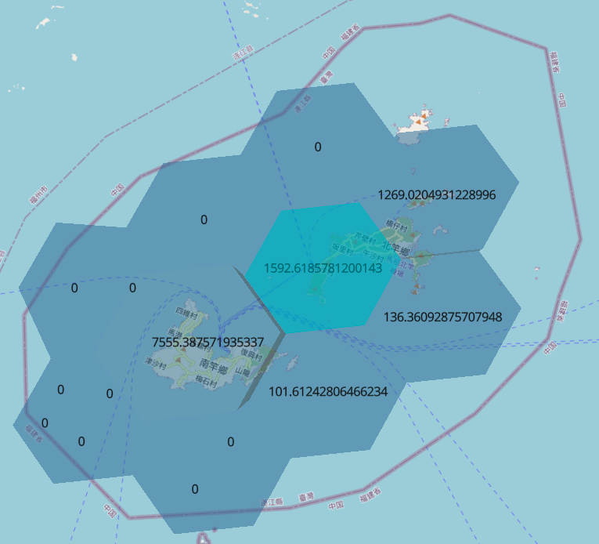
observation
Resolution = 6 on offshore island
Actual value: 13,645
Hexagons: 10,655
- > There is a discrepancy
in the population count for the offshore islands.
Two possible solutions:
Do not include the offshore islands.
Set the distance parameter to 2

Slide 15
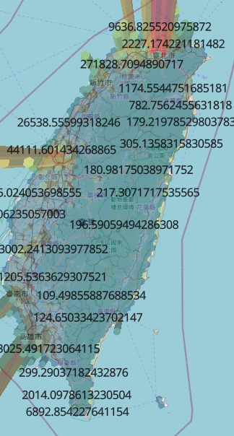
Verification - solution of distance
Distance = 0 on mainland in Taiwan
Notes:
hex_ring
k_ing

Slide 16
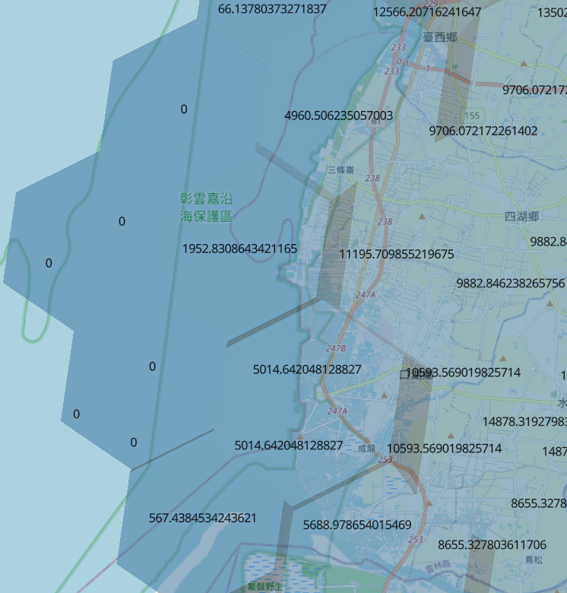
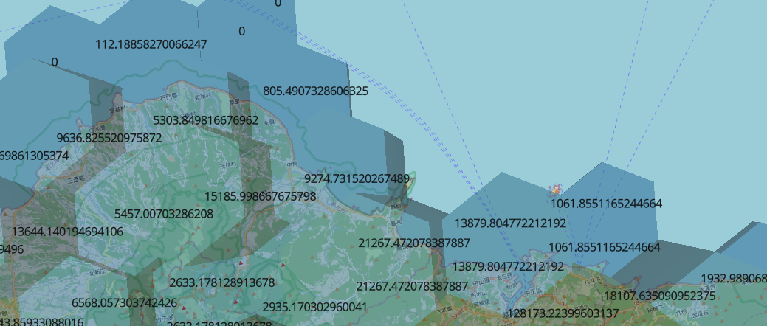
Verification solution of distance
Distance = 1
Distance = 1

Slide 17
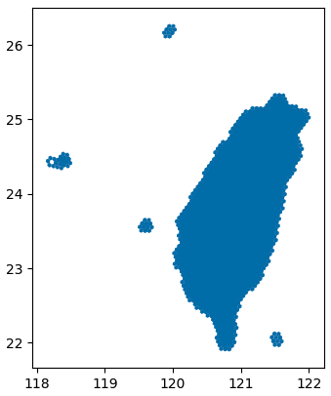
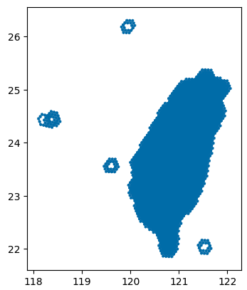
Verify solution of distance
Distance = 1
Distance = 2
Resolution = 6
Excluding offshore islands
Actual value: 23,092,331
Hexagons: 23,091,097.33
Error = 0.005%

Slide 18
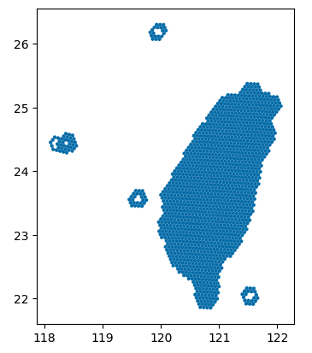
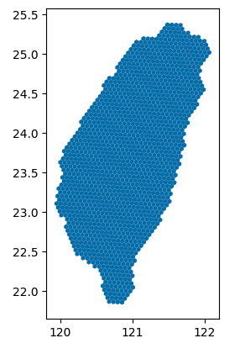
Include or exclude offshore islands
including offshore islands
excluding offshore islands
Notes:
取到小數點後第二位

Slide 19
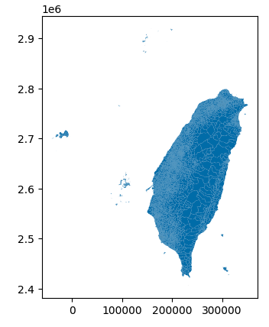
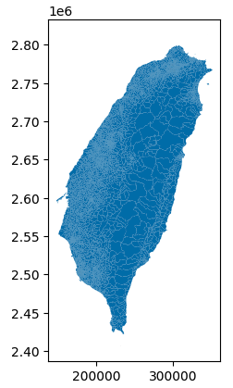
Verification – solution of excluding offshore islands
Resolution = 6
Actual value: 23,375,314
Hexagons: 23,324,000
Error = 0.21%
Resolution = 6
Actual value: 23,092,331
Hexagons: 23,090,009.33
Error = 0.01%

Slide 20
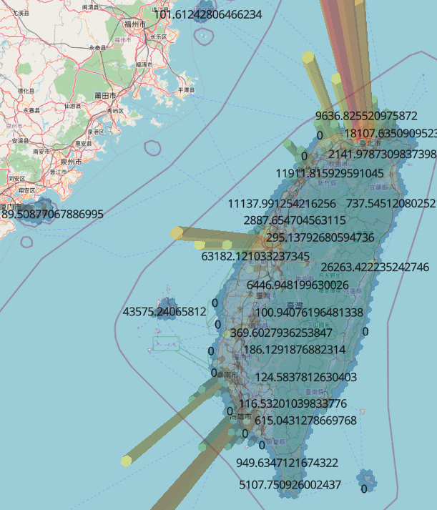
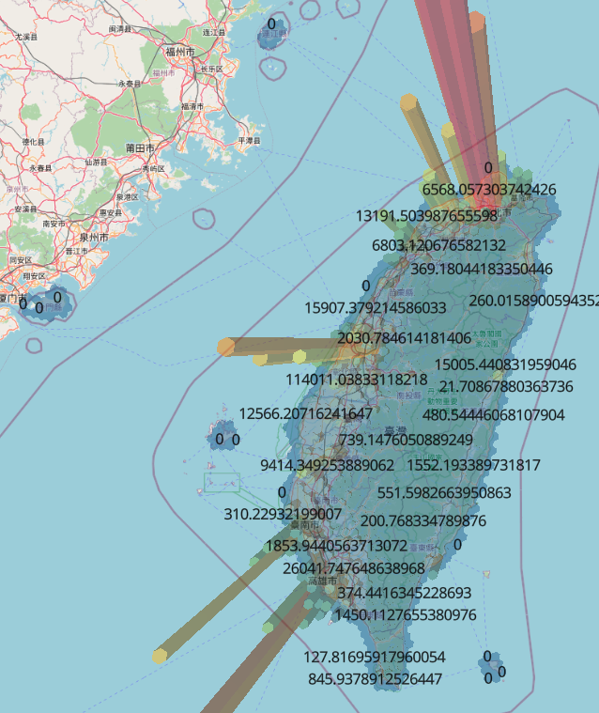
Verification – solution of excluding offshore islands
Resolution = 6
Distance = 1

Slide 21
Process summary for each dataset

Slide 22
Popularity

Slide 23
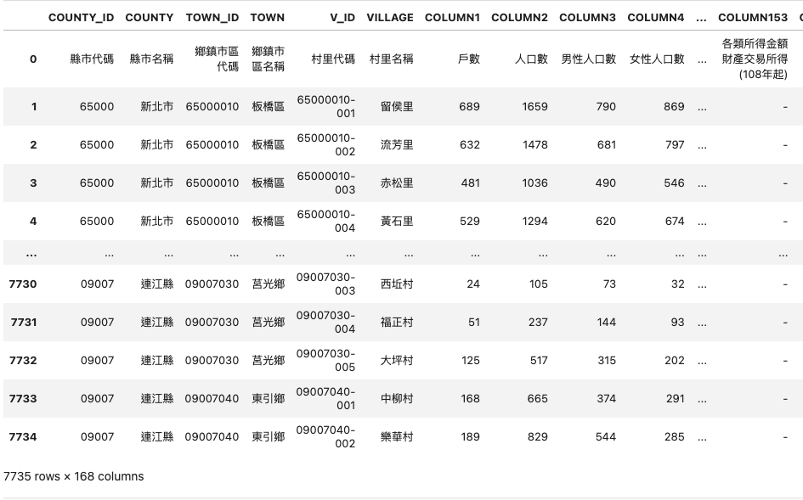
Popularity – raw data
The column of V_ID is for merging data (unique)
The column of COLUMN2 is population in village

Slide 24
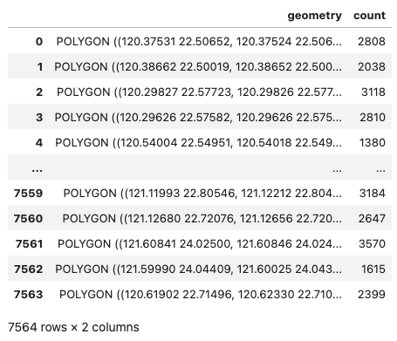
Popularity - preprocessing
Retrieve COLUMN2 (population count) from the raw data.
Use V_ID to perform the merge.

Slide 25
Algorithm
Step1: Calculate the intersection area between hexagons and population regions to obtain the area ratio.
Step2: Multiply the area ratio by the population count of the population regions to estimate the population for each area.
Assume the population is evenly distributed.
.
.
.
40/120 = 1/3
1000 * 1/3 = 333 people
area
40cm^2
383 people(This hexagon's population count)
10/200 = 1/20
30 * 1/20 = 1.5 people
=
area
10cm^2
Total population count
50/200 = ¼
30 * ¼ = 7.5 people
7.5 people(This hexagon's population count)
(for Validate)
600 people
50cm^2
30 people
200cm^2
Area
50cm^2
1000 people
120cm^2

Slide 26
Population must not contain decimals
Raw data of total population = 23092331
preprocessed data of Total population before rounding = 23091098
error = 0.0053%
preprocessed data of Total population
after rounding = 23091105.0
error = 0.0053%

Slide 27
Popularity - validate
Sum the population counts from the raw data = 23092331
≈ Total population in the data used for mapping = 23091105

Slide 28
income

Slide 29
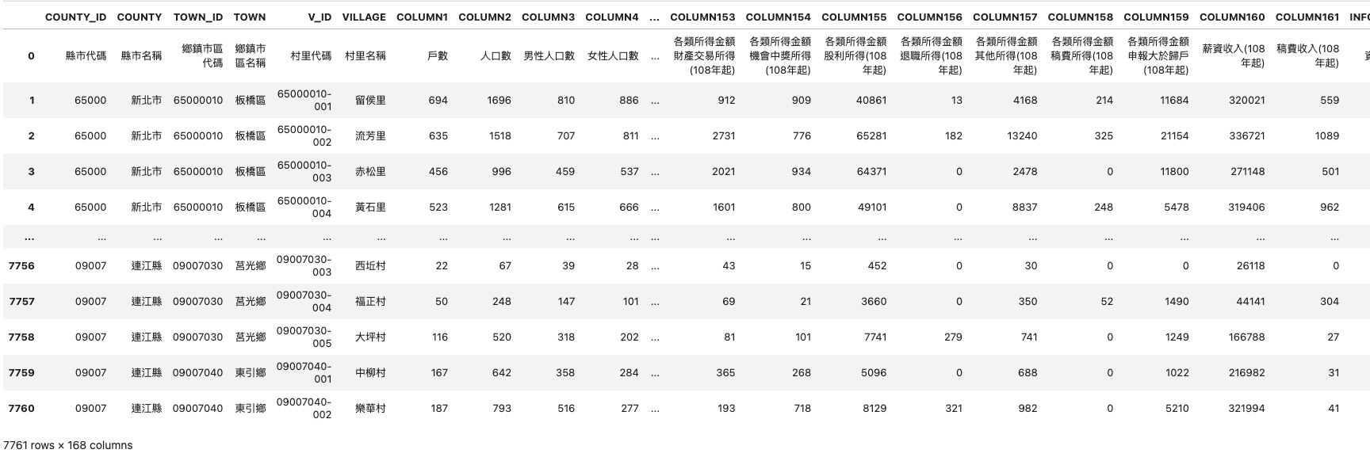
Income – raw data
Although the finest granularity is at the village level, there are only 7760 data entries. However, Taiwan has 7936 villages -> merge into districts.
COLUMN160 = The total salary income reported by all households in that village for the year 110.
COLUMN1 = Number of households
(Unit: thousand dollars)

Slide 30
Income - preprocessing
If a village's income is missing (NA), use the average total income of the villages within the same district to fill this missing value.
Calculate the average household income of the district by dividing the total annual salary income of the different villages in the district by the total number of households in the district. This results in the average household income for the district (average annual family income of the district).
Use TOWN_ID to perform the merge to obtain fields with geometry.
Finally, use the district average annual family income for mapping!

Slide 31
Income - validate
Reverse the calculation to obtain the same number (similar to a mathematical verification).

Slide 32
Charge station

Slide 33
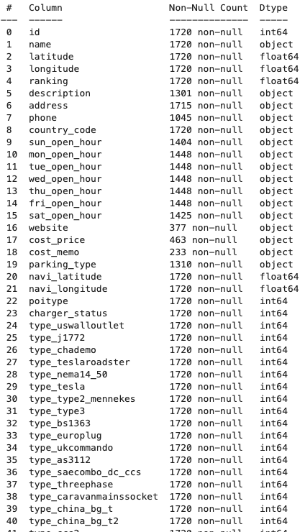
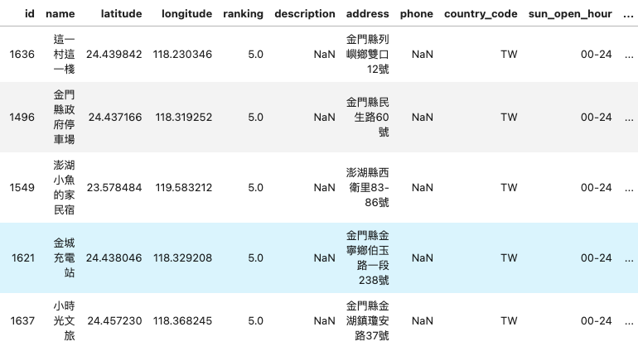
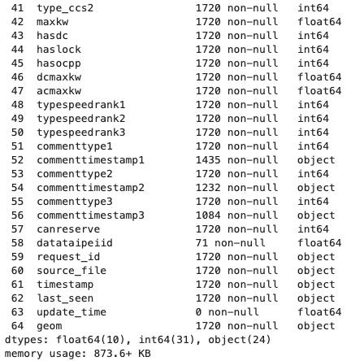
Charge_station – raw data
Geom is in WKT (Well-Known Text) format.

Slide 34
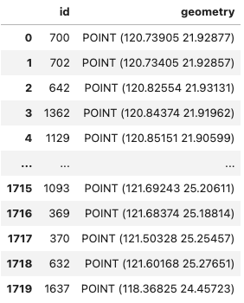
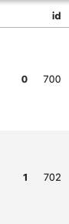
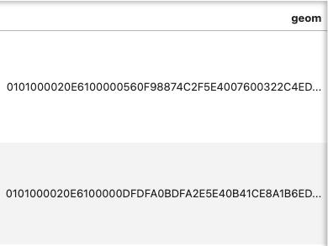
Charge_station - preprocessing
Keep the geom and id fields; the id is for validation purposes.
Convert geom into geometry: transform from WKB to WKT, then convert the WKT string to an object, and finally convert the object into geometry.
Run an algorithm to calculate the number of points within each hexagon.
Finally, use the data on the number of points within each hexagon for mapping!

Slide 35
Algorithm
Calculate the number of points in each hexagon.
It represents the number of charging stations in this region.
Points on the boundary of the hexagon will not be included.
There are eight points, which correspond to eight charging stations.
There are three points, which correspond to three charging stations.

Slide 36
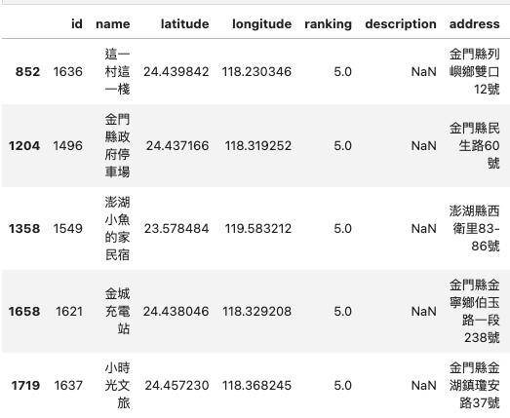
Charge_station - validate
Calculate that the raw data consists of 1720 rows, indicating there are 1720 charging stations across Taiwan.
Sum the number of charging stations within each hexagon, resulting in a total of 1715 charging stations.
Use IDs to identify the remaining 5 charging stations, all of which are on the offshore islands, confirming the accuracy.

Slide 37
The reasons for the discrepancy
Some areas might not be covered by hexagons
Ans: Adjusting the distance parameter to 1 or 2 might help ensure coverage.
There might be errors in the area calculation method used by .area
Ans: The .area function is written in C and calculates the area using the Gaussian area formula by dividing the shape into triangles and calculating the area using the vertices. This method is designed for 2D areas, and the error is negligible.
Population distribution might not be uniform, so using the population distribution area ratio to calculate the population within hexagons might introduce errors
Ans: Summing the total population should not lead to significant errors.
Decimal point calculations might have been overlooked or estimated incorrectly - unavoidable
Ans: This is an inherent limitation and cannot be completely avoided.
執行

Slide 38
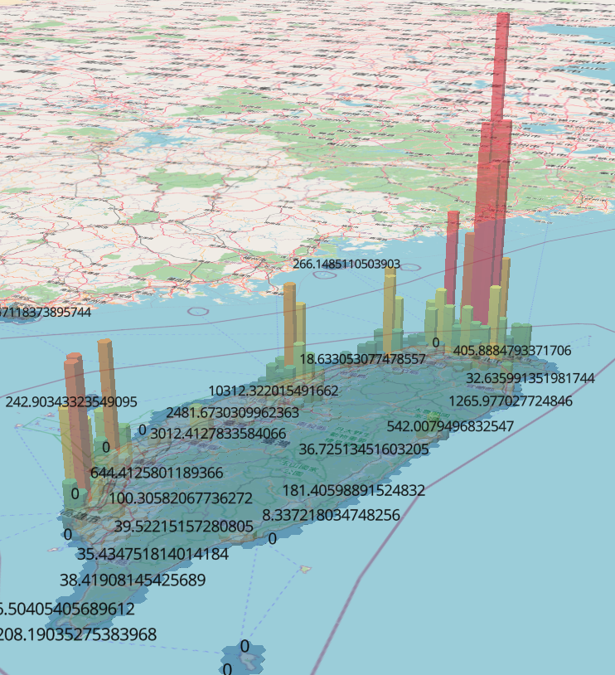
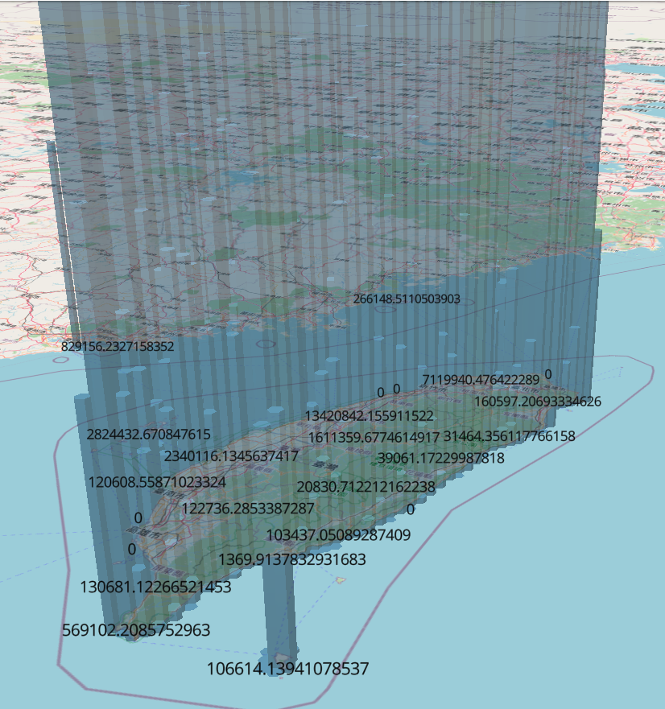
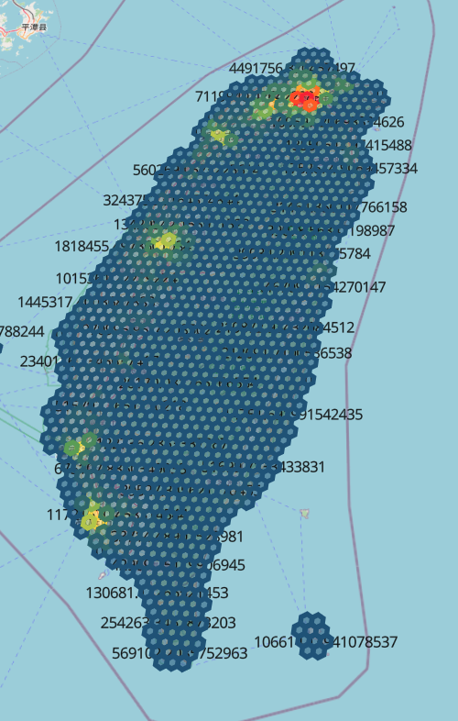
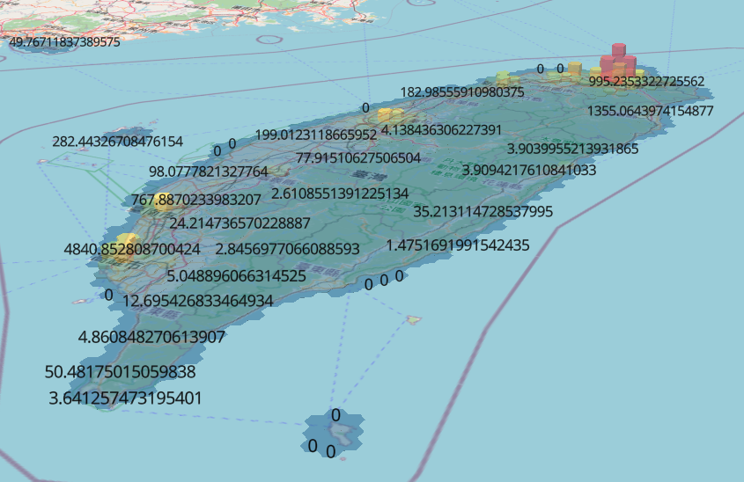
Income sum
單位為千的3D income
有離島 distance = 1
resolution = 6
無四捨五入
未處理單位的3D income
未處理單位的2D income
單位為萬的3D income
Notes:
取到小數點後第二位

Slide 39
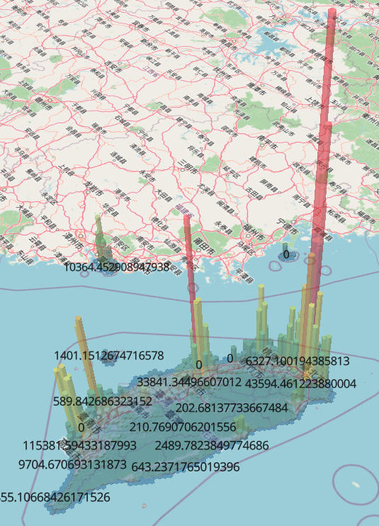
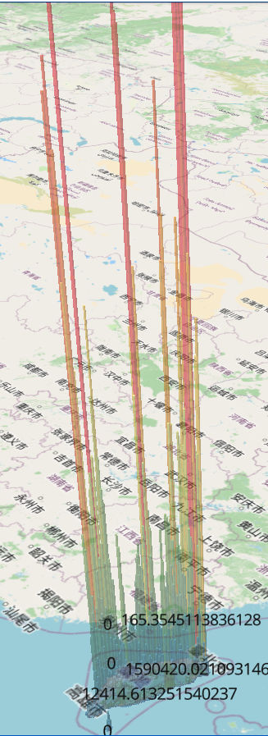
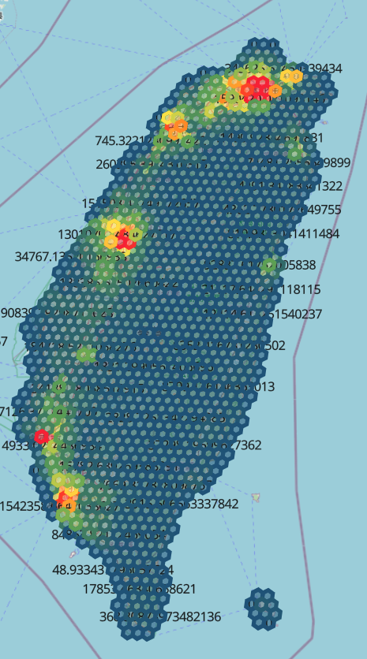
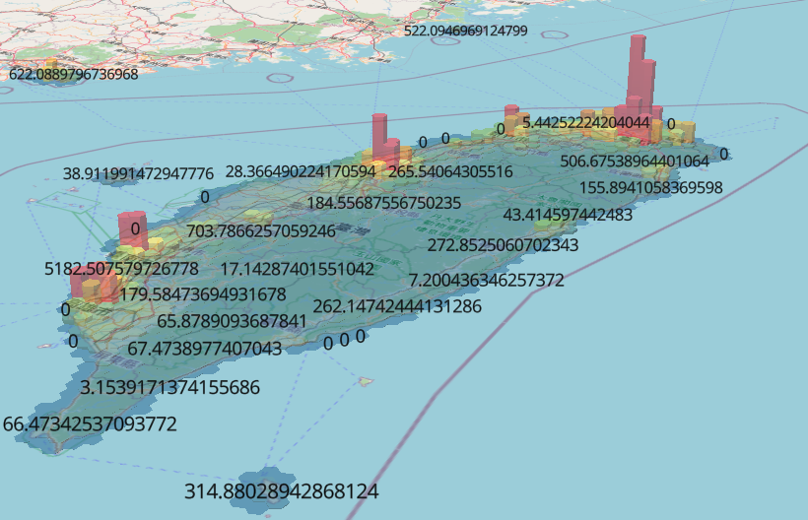
Income mean
有離島 distance = 1
resolution = 6
無四捨五入
單位為十的3D income
未處理單位的3D income
未處理單位的2D income
單位為百的3D income
Notes:
取到小數點後第二位

Slide 40
Any Questions?
不久的明日，所有人都會用這種方式來保護自己的生活

